Slide 1


(Some) Social impacts of Artificial Intelligence
Alberto Lumbreras AI Researcher
www.albertolumbreras.net alberto.lumbreras@gmail.com

Slide 2
What is AI?
AI has moved forward with Science and Resources
Artificial Intelligence (1955)
Umbrella term. Not everyone likes it. algorithms + computers
IA
ML
Machine Learning (1960) + statistics + data
DL
Deep Learning (2010) + neural networks + computing power + lots of data
Large Language Models (2018) + parallel computing + much more data (ChatGPT)
LLM

Slide 3
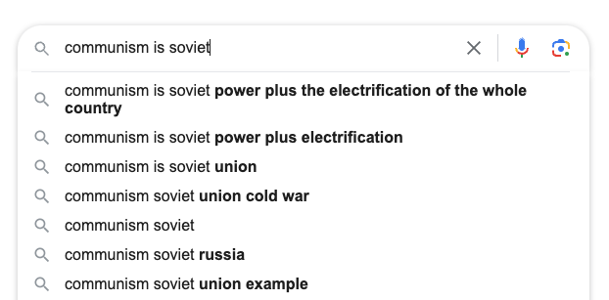
What is a language model
A model that learns the probability of each possible sentence

Slide 4



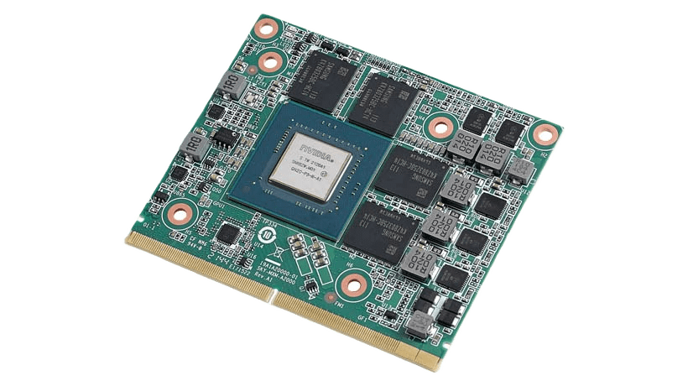
How are language models trained
A stunningly simple method
Huge corpus of user-generated data:
Huge computing power (for big and fast networks):
x 3000
piedra
Update the network and
repeat until error is low
Tierra
-1
+1
Neural Network
…
Neural Network
Neural Network
Neural Network
Arriba parias de la Tierra […]
Arriba parias de la Tierra […]

Slide 5
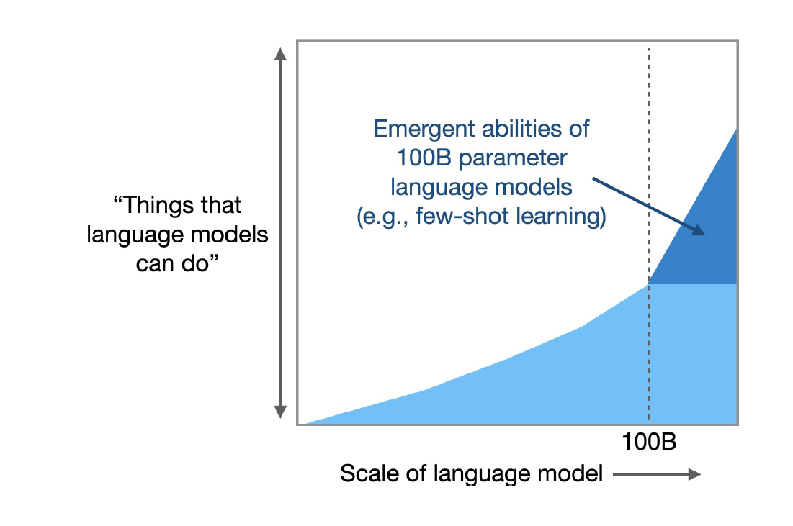
At a given scale, LLMs show emerging properties
And this was a surprise
Chat
Perform tasks it has never done before
Autocompletion
Learn from input examples

Slide 6



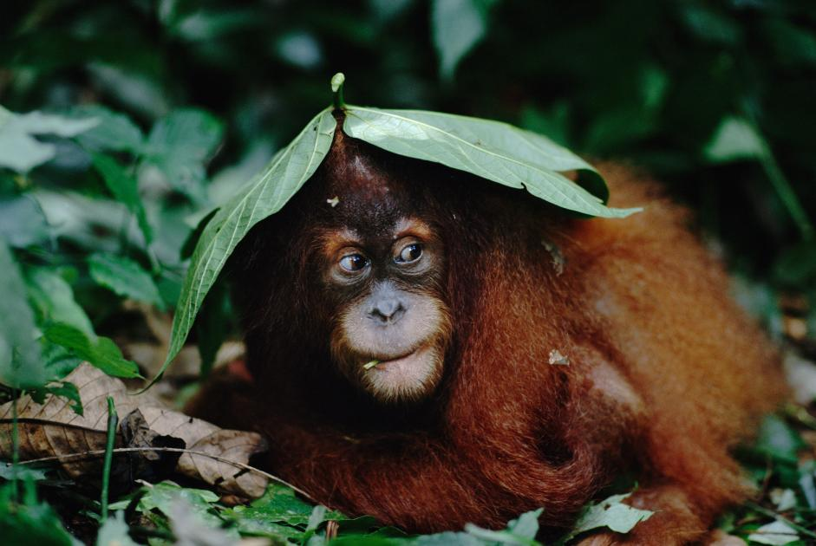
It doesn’t mean AI systems will take over the world
AI systems are not that smart (they just outperform humans in some specialized tasks)
But event if they were smarter, they are not social species. Dominance is a strategy of (some) social species.

Slide 7
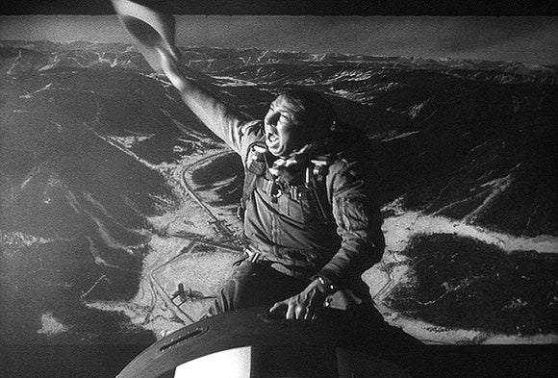
But it can get out of control
Unemployment
Increase North-South gap
Biases in decision making
Fake news
More CO2 emissions
Autonomous IA agents doing unexpected things
Hallucination and lack of factuality

Slide 8


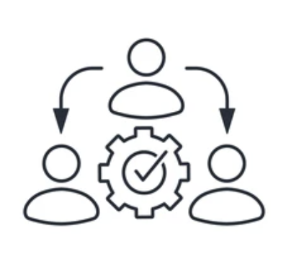
Challenges and tasks
Democratic AI
Sustainable AI
Redistributive AI

Slide 9

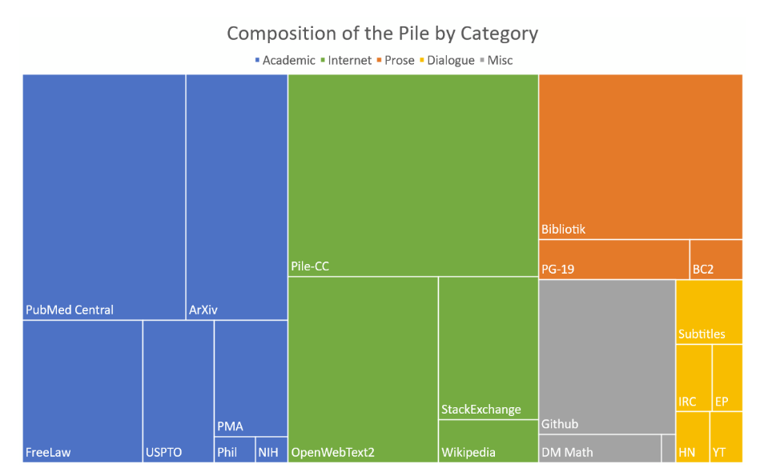
Democratic AI
The COMPAS software was used to guide judges in the US
Why (1): To reduce and control bias and discrimination
The composition of the training dataset has a huge effect in the model outputs

Slide 10
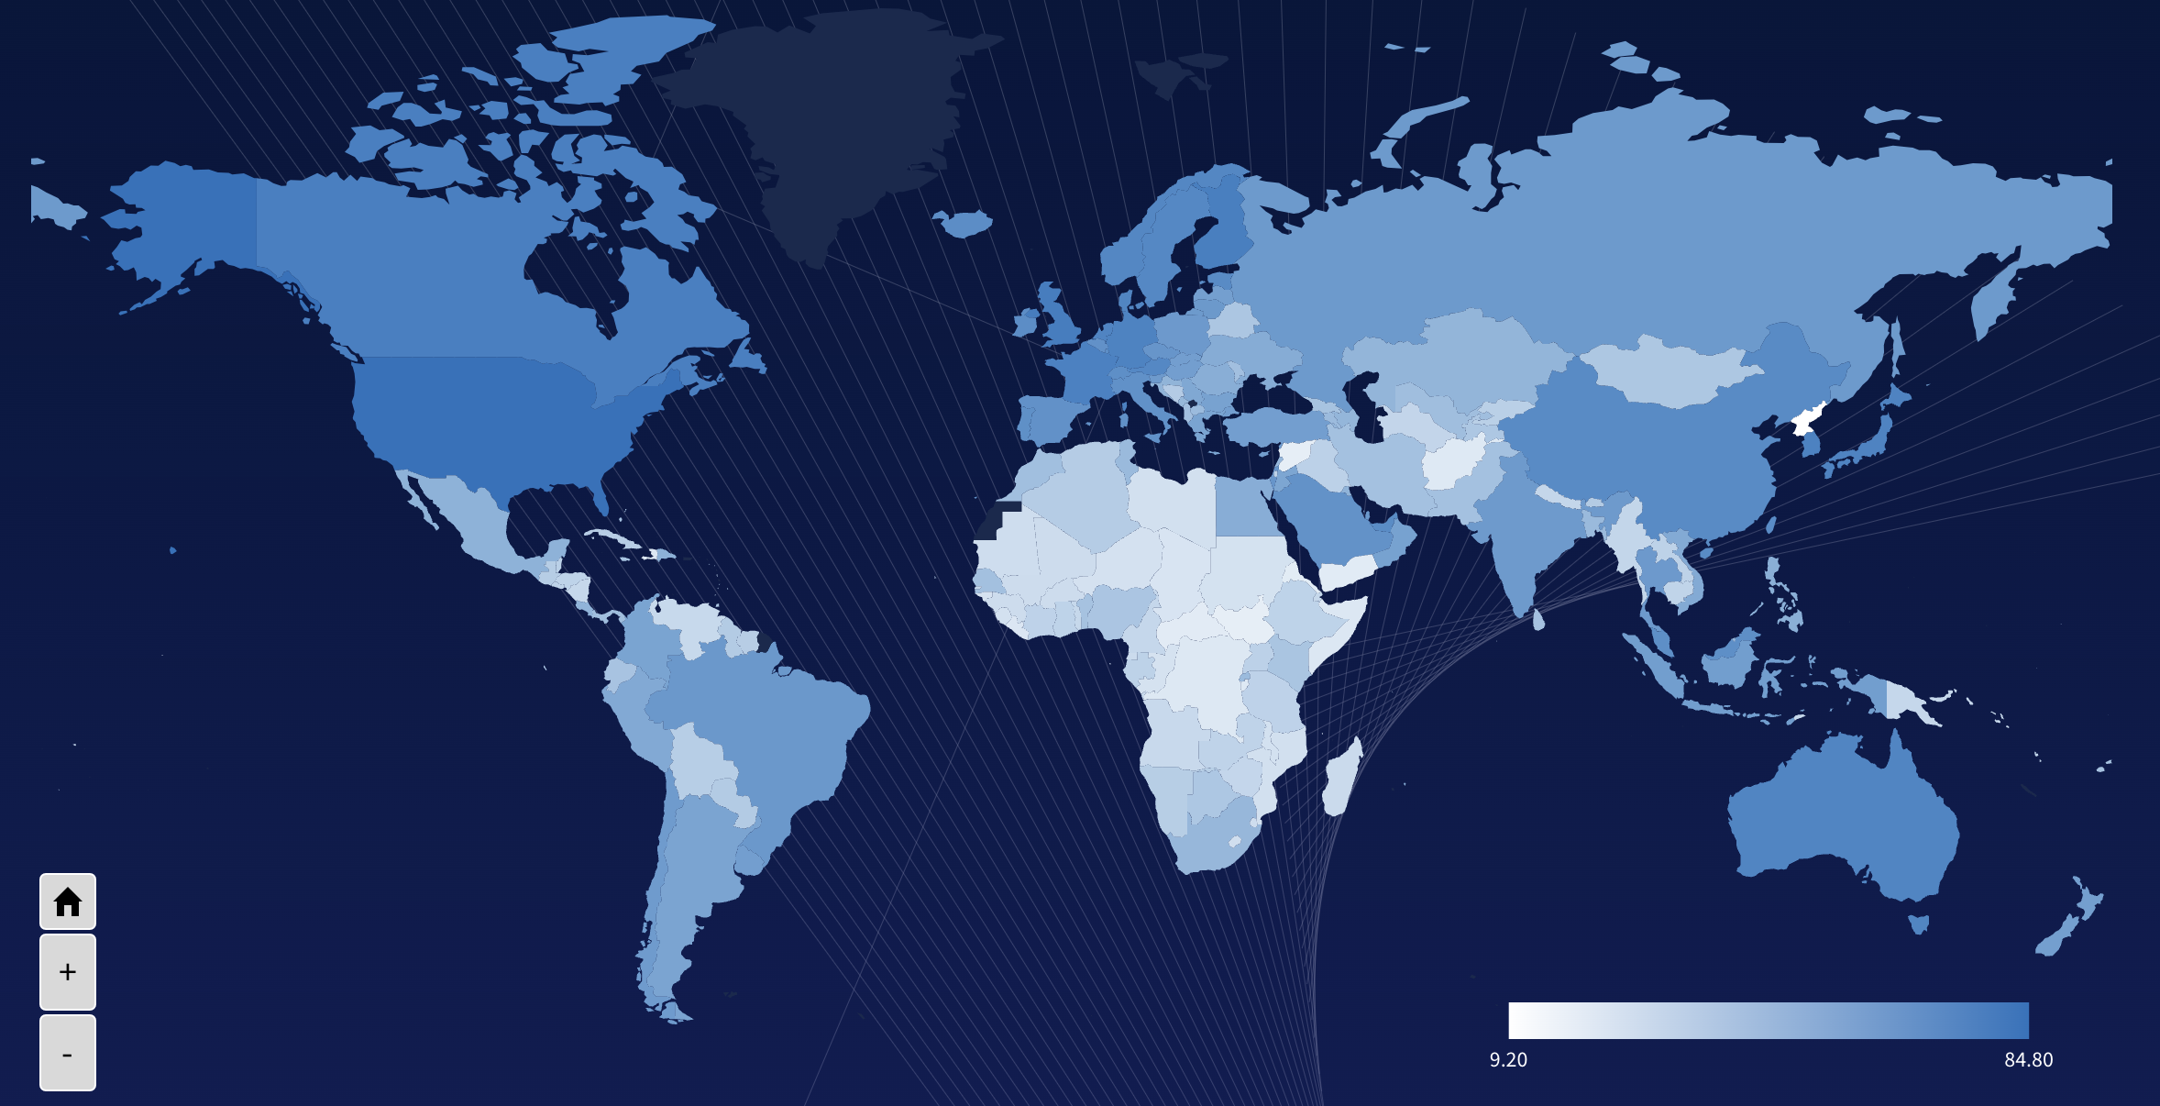
Democratic AI
Why (2): To prevent augmenting the global north-south divide
Source: https://oxfordinsights.com/ai-readiness/ai-readiness-index/

Slide 11
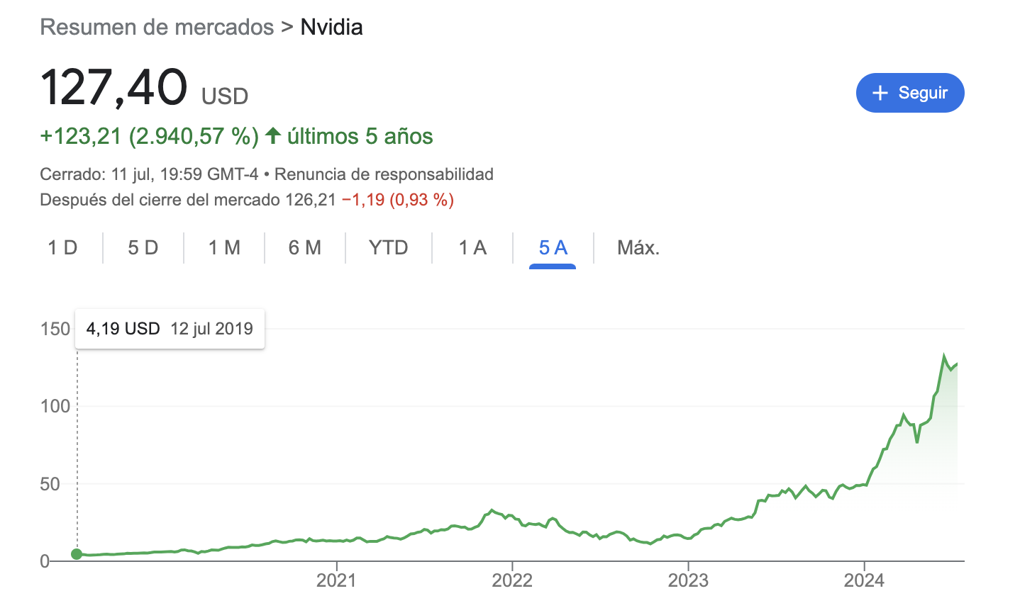
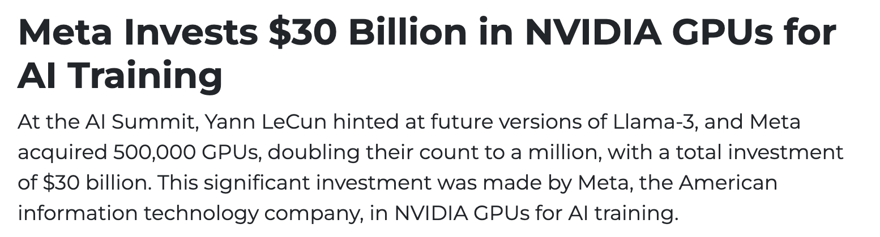
Democratic AI
Why (3): To avoid dependencies on GAFAM
Meta has x500 GPUs than the biggest French computing cluster Jean Zay GPU shortage. NVIDIA denies orders from smaller companies since it privileges GAFAM
Nvidia stock

Slide 12
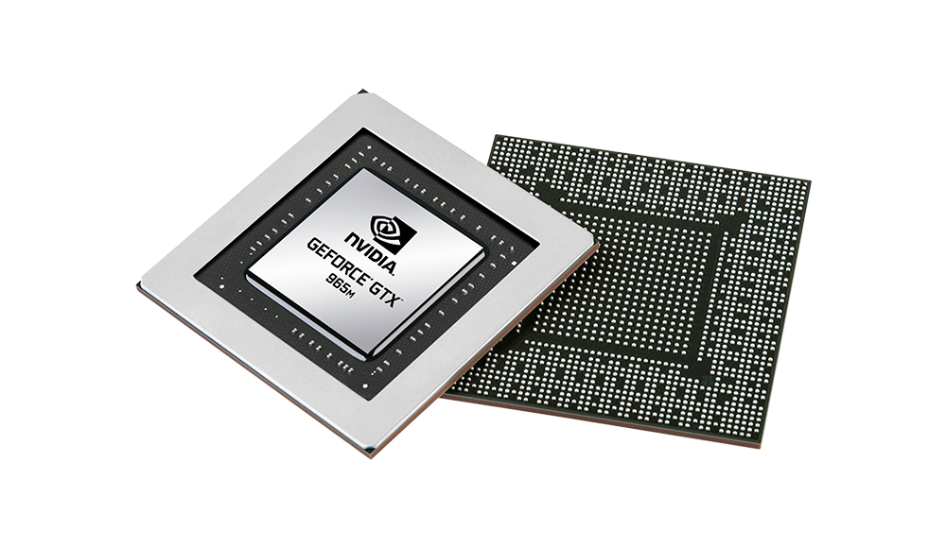

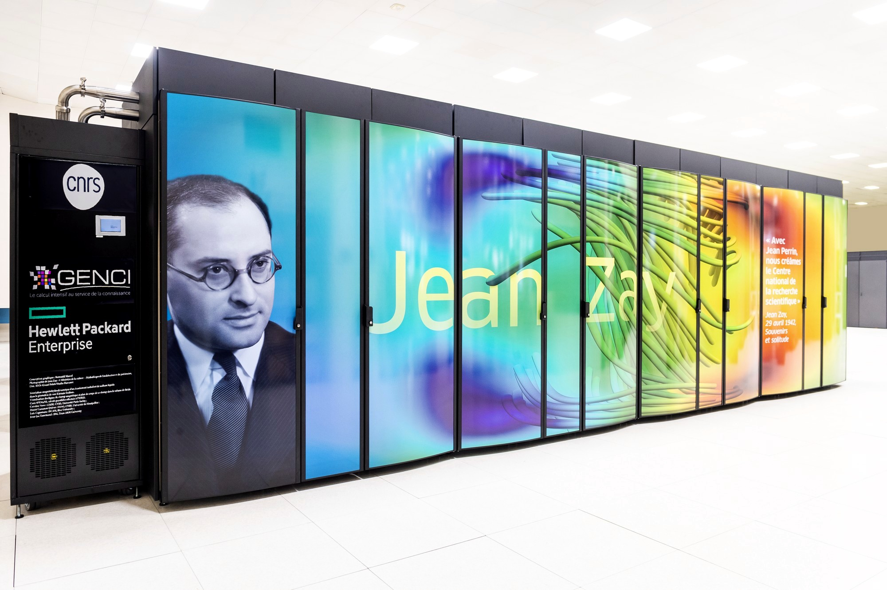
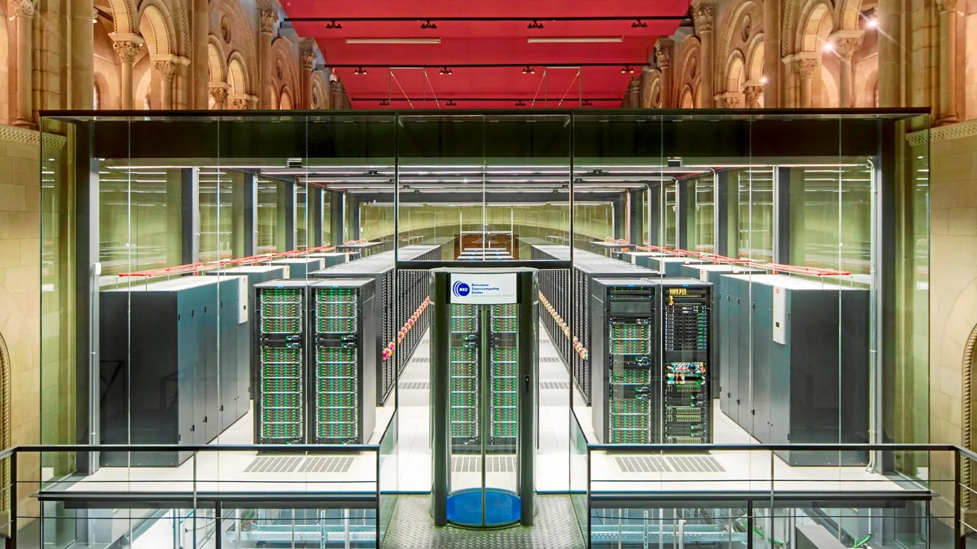






Democratic AI
How (1): A public cloud service
European actors either rent American cloud services or buy GPUs (no stock)
Jean Zay
Mare Nostrum
What about a public European cloud computing service?

Slide 13
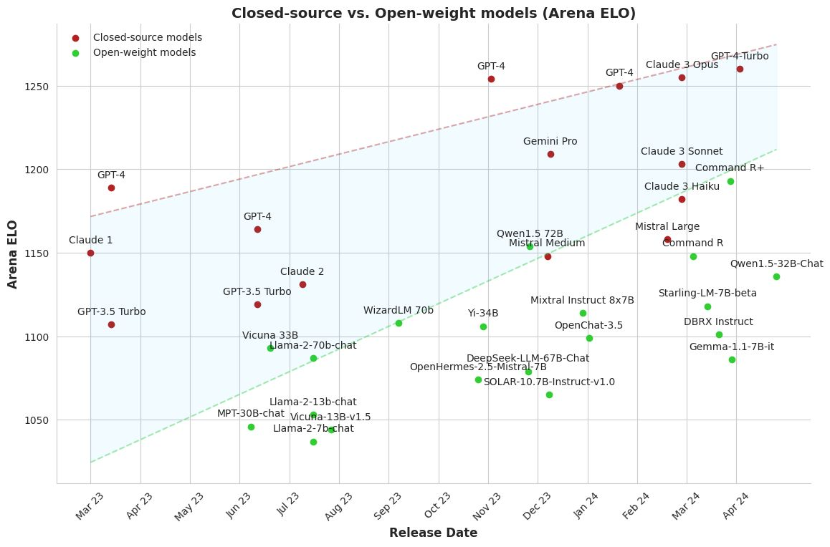

Democratic AI
How (2): Open-source models that we can reproduce and understand their biases
Open data
To understand and detect biases
Open model
So that everyone can use it
Open training method So that everyone can reproduce it

Slide 14
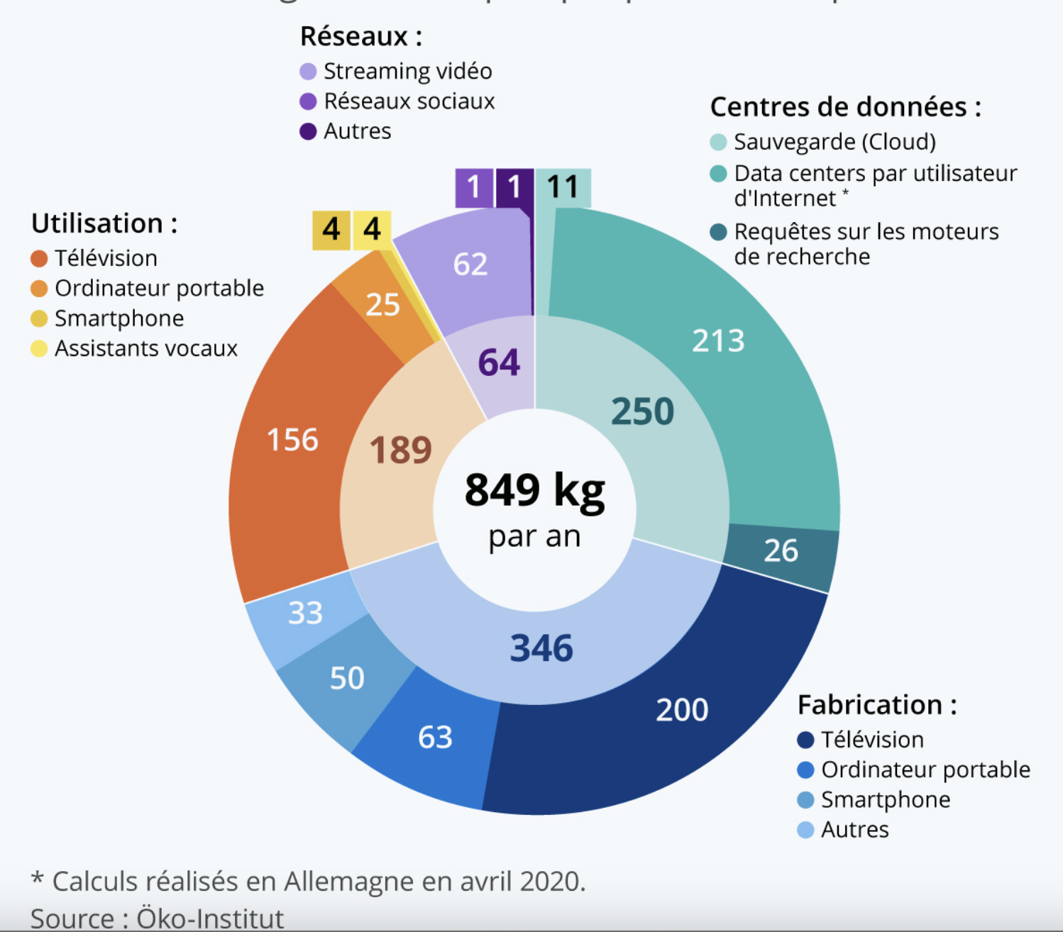
Sustainable AI
Why (1): To avoid more CO2 emissions
CO2 emissions from digital technologies (1 person)
Digital technologies consume 4% of the global carbon footprint (2023).*
Generative AI is very energy consuming: Training ChatGPT emitted 3000 tEqCO2 and each question consumes x10 more energy than a search query
* Guillaume Pitron. L’enfer numérique. Voyage au bout d’un like. Ed. Les Livres qui Libèrent (2023)

Slide 15
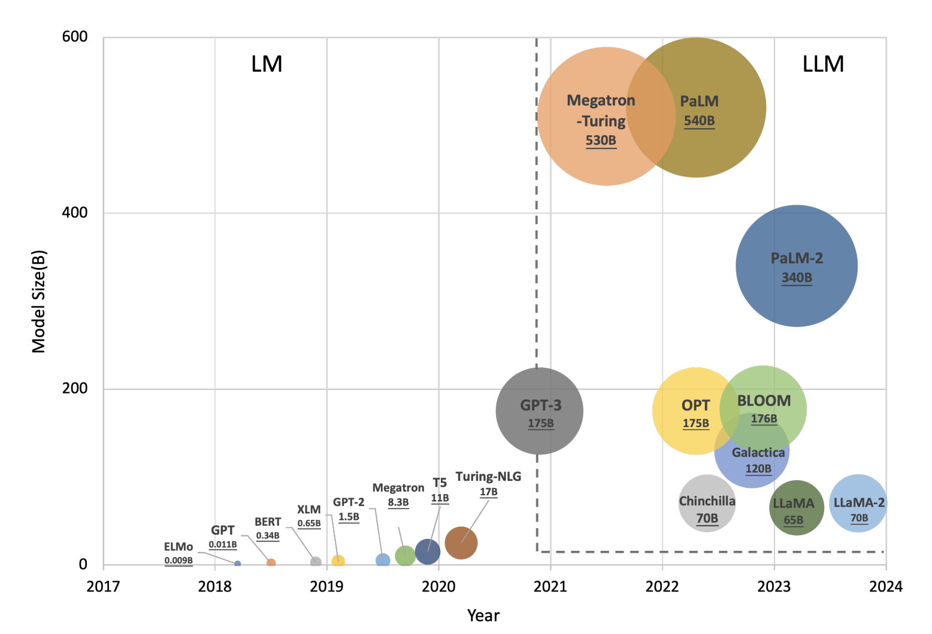
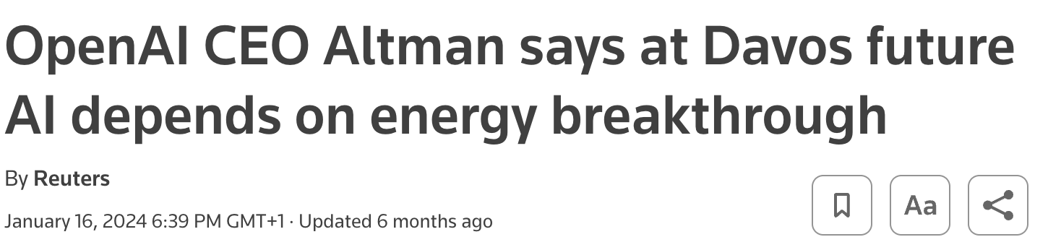
Sustainable AI
Why (2): Models are getting bigger

Slide 16

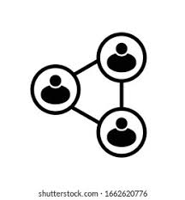

Sustainable AI
How: Regulate, federate, reduce
Regulation for energetic sobriety
Federate resources
Smaller models (already happening)*
* But mind the Jevon’s paradox: more efficiency leading to more consumption
16

Slide 17
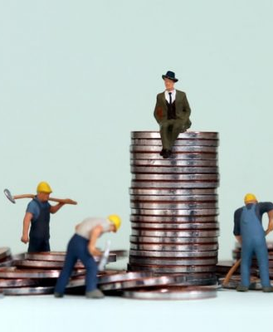
Redistributive AI
Why: To prevent the rich from becoming richer
Productivity will increase (from personal experience, coding x3 – x5*)
Either it goes to the workers or it becomes new surplus for the capital. If it goes to the capital, it will lead to unemployment and more inequality
* But coding is just a tiny part of my job. Overall productivity increase will be diluted by time in other areas such as meetings, planning, reading…

Slide 18

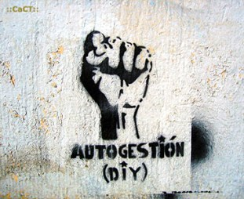
Redistributive AI
How: AI as an emancipation tool
In the short term
Robot taxes
No replacement by machine if quality of service deteriorates (e.g., hospital)
In the mid-long term
AI lowers the barrier to build services and products. We should explore AI as an emancipation tool: better coordination, circular economy, open non-profit platforms, information, open education…

Slide 19
www.albertolumbreras.net alberto.lumbreras@gmail.com

